Slide 1
Hackathon Training: Integrating VMware API’s and Amazon Echo (Alexa)
VMTN6721U
Cody De Arkland (@codydearkland)
#VMworld2017 #VMTN6721U

Slide 3
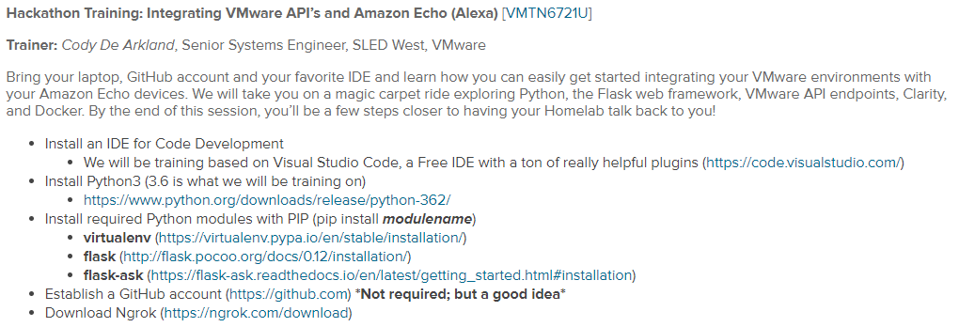
“Alexa…What Should I Have to Get Started”

Slide 4
Great Resources
VMWare{CODE} API Explorer
https://code.vmware.com/explorer-apis
Python Flask Documentation
http://flask.pocoo.org/docs/0.12/
Flask-ASK Documentation Page
https://flask-ask.readthedocs.io/en/latest/
Cody De Arkland’s Blog on Amazon Echo Integration
https://www.thehumblelab.com/integrating-echo-vmware/
William Lam’s Blog on Furthering Echo Integration
https://www.virtuallyghetto.com/2017/06/introducing-alexa-to-a-few-more-vmware-apis.html

Slide 5

You can clone the training content for this repository at the following GitHub URL
https://github.com/codyde/Hackathon-Training
Install Git on your System
Change to Desired Directory
“Git Clone” the URL Above
Enjoy the Hackathon Content at Home!
Fork and Contribute!

Slide 6
“Alexa…What Are We Going to Accomplish”
Programmability with the Amazon Echo
Evolution of VMware API’s
Echo Interaction with API and SDK’s
Formatting Responses
Deploying Skills

Slide 7
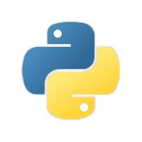

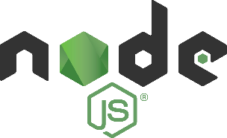





So Why The Echo?
Extremely Extensible
Multiple Language Support
Python, NodeJS, Anything “REST Capable”
Many Frameworks
Standard SDKs/Mature Community SDKs
Easy to get Started
Directly Integrated with all things AWS
AWS
Lambda
AWS CodeBuild
AWS CodePipeline

Slide 8
Hackathon Training Mission
Create a Basic Flask Server in Python
Learn how to build interaction between Amazon Echo and vCenter API’s
Build a basic configuration interface
Design creative responses to Amazon Echo Intents
Learn to host a skill

Slide 9
Lets Get Started!
Follow Along in the GitHub Repository
https://github.com/codyde/Hackathon-Training

